Slide 1



Managing Temple Services
Managing Devotee Service Schedules

Slide 2


Agenda
Business Requirements
Sling Software Features/Concepts
Onboarding Data Needs
End User Requirement
Management Styles

Slide 3

Business Requirement
Two locations – 25 + 5 devotees
Devotee can quit service or take time off for some days
Anyone can be engaged in any type of service.
New Devotee can join anytime
Temple President should should be able to
Assign services to each devotee
See who is engaged / not engaged in the "Engagement hours"
Ability to send weekly service schedule to each devotee
Devotees have hours of service engagement and time-offs

Slide 4
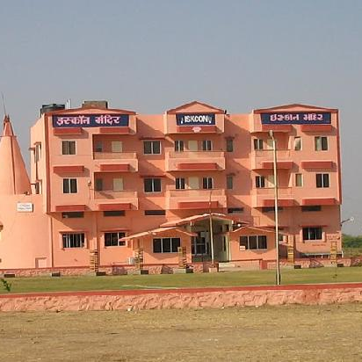
Additional Business Requirements
This should remind Temple President of any devotee not engaged
Remind devotees of their upcoming tasks - mobile/whatsapp or in the app
Admin ability to assign engagement hours or time off
Attribute "task points" to tasks accomplished
Admin User Role should be able to
Schedule
Mark User Time Off
Assign/Unassign Tasks

Slide 5
Types of Services
Services | Position(s)
Altar and Aarati services | Pujari, Dresser, Garland Maker
Book distribution | Book Distributor
Cow Services | Milkman
Prasadam | Cook, Shopper, Cleaner
Donation Box | Public Relationship (PR) Manager
Media Services | Web Master, Camera Man, Sound Engineer
Preaching | Speaker, Lecture Coordinator

Slide 6
Types of Services
Services | Position(s)
Altar and Aarati services | Pujari, Dresser, Garland Maker
Book distribution | Book Distributor
Cow Services | Milkman
Prasadam | Cook, Shopper, Cleaner
Donation Box | Public Relationship (PR) Manager
Media Services | Web Master, Camera Man, Sound Engineer
Preaching | Position(s)

Slide 7
Sling Concepts and Features - Roles
Roles
Admin
Full Access, Admin can create other admin
Manager
Manager can changes in the locations they are assigned to. They can create shift, approve shift exchanges, enter and approve time-of
Employee
View and print their own schedules, apply for their own shifts, Apply to available shifts and make their own shifts available, they can communicate to all other employees via messages,
They cannot create their own shift, position or location in their profile

Slide 8
Sling Concepts and Features -Employee
Online/Mobile App
Navigation - Employee
Dashboard
Profile
Unavailability
Co-workers
Settings
Schedule
Tasks
Messages
Newsfeed

Slide 9
Sling Concepts and Features -Admin
Navigation - Admin
Dashboard
Dashboard
Notifications
Roster
Employees
Employees -> Add Employee
Join Requests -> Approve/Reject
Positions → Add/Edit Positions
Locations → Add/Edit Location
Groups → Add/Edit/Delete Group
Settings
Schedule
Tasks
Messages
Newsfeed

Slide 10
Sling Concepts and Features -Admin
Navigation - Admin
Dashboard
Schedule
Full Schedule
Create Shift
Publish Shift
Events -> Unassigned/Available/Unassigned shifts/Time Offs/Unavailability
Filter by Location/Position/Events/Publish/Worker
My Locations
Pending Approval
Unavailability
Tasks
Messages
Newsfeed

Slide 11
Onboarding Data Needs
Add/Edit Position
Have list of position or role
Add/Edit Location
Schedule – Create Shift
Unavailable first later to Available ones
Adding “Employee” - Devotee Volunteers
Individually/CSV file ( Name, Email, Phone, Location, Position, Role)

Slide 12
Roster Setup – Best practices
Plan the roster before adding individual names.
Share schedule options with the entire staff.
Fill busy shifts with the most experienced and skilled staff.
Automatically handle availability and time-off requests online.
Make sure everyone receives two days off.
Allow your staff to check their roster.
Give your staff enough time to plan for obligations outside of work.

Slide 13
References
Step by step setup guide for admin
https://www.youtube.com/watch?v=A74i9tzbtB8
Roster Tips for Managers
https://mitrefinch.com/blog/9-staff-roster-tips-that-forward-thinking-managers-should-use/
https://www.goroster.com/good-roster-planning-matters/

Slide 14
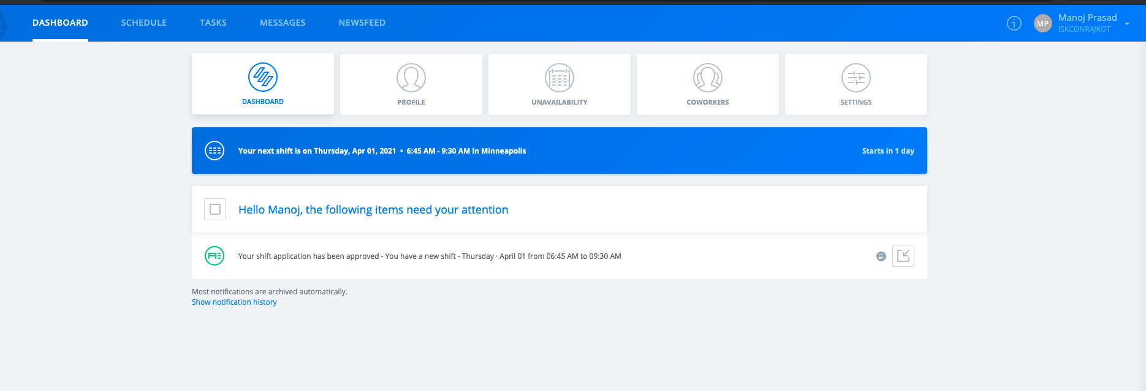
Employee Dashboard

Slide 15
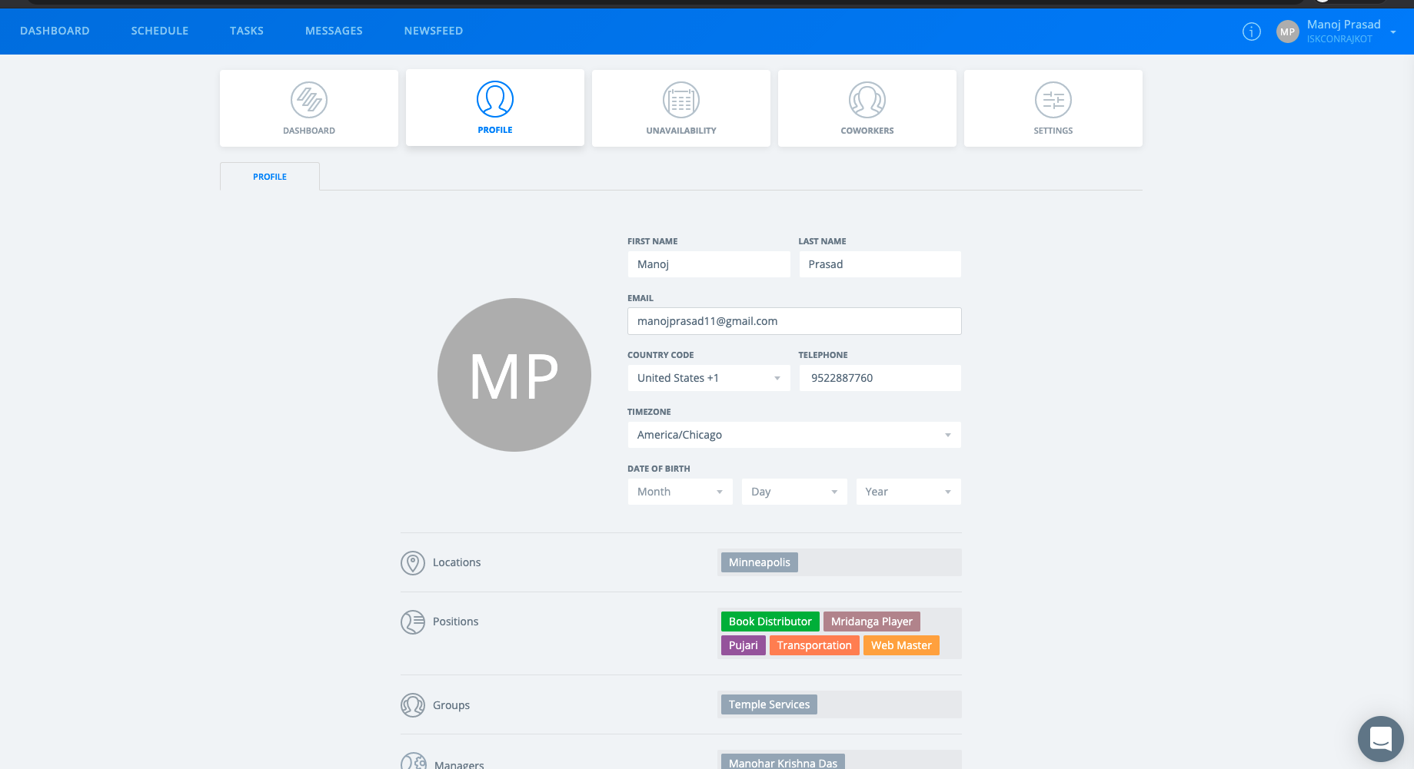
Employee Profile

Slide 16
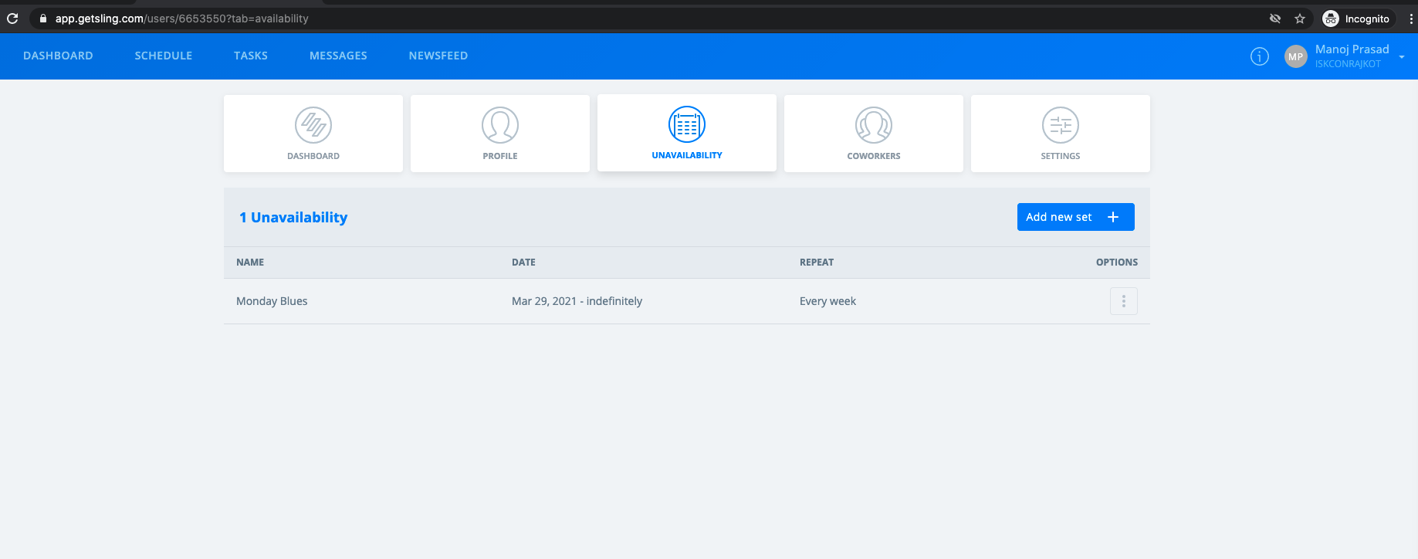
Employee - Unavailability

Slide 17
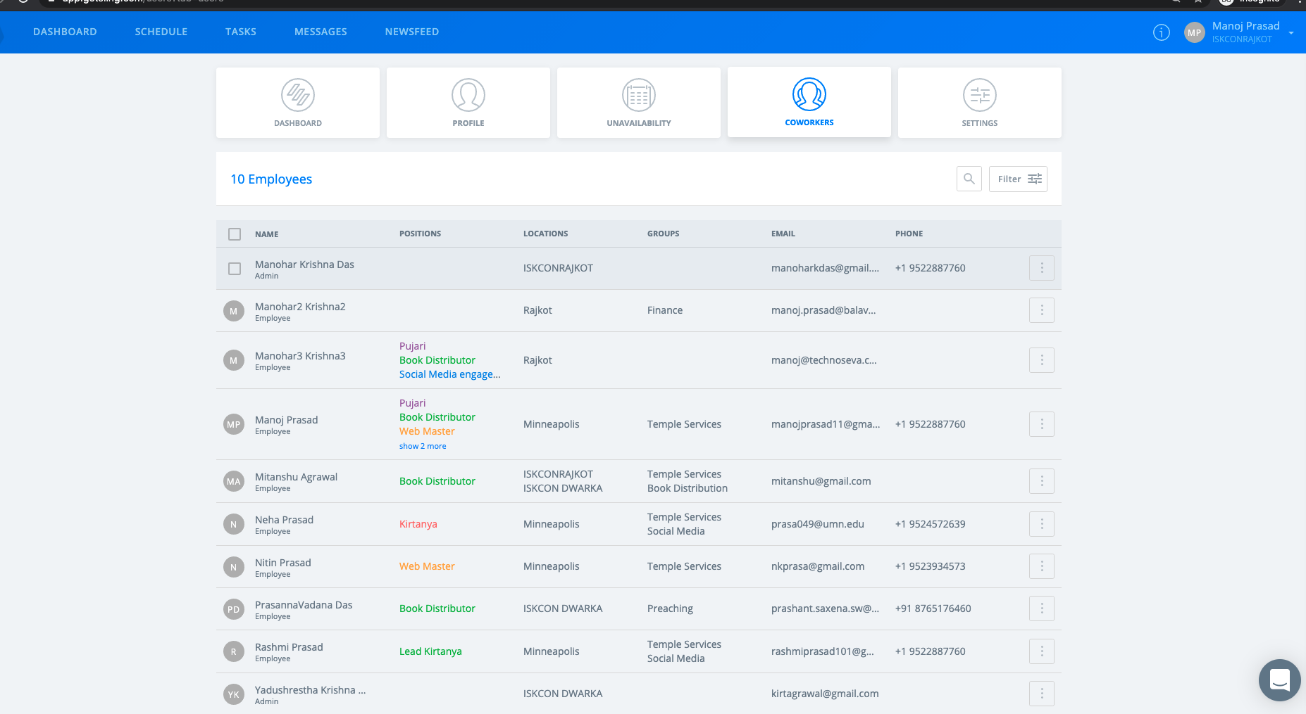
Employee – Co-workers

Slide 18
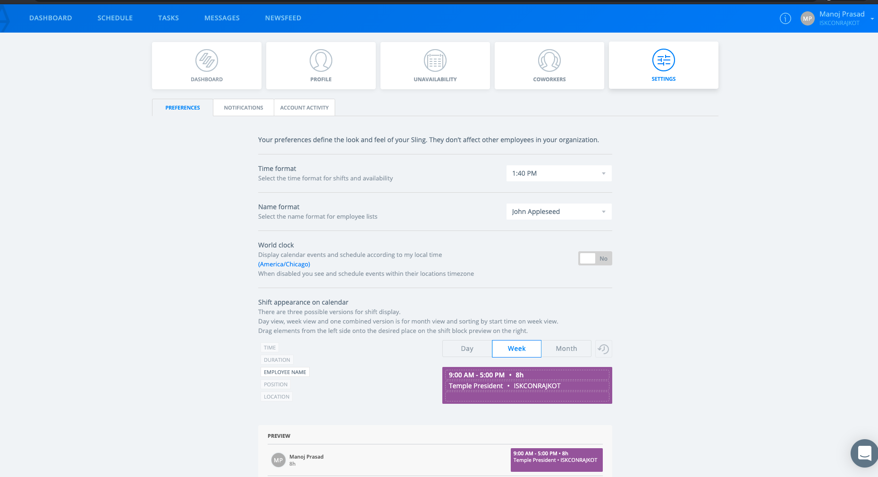
Employee - Settings

Slide 19
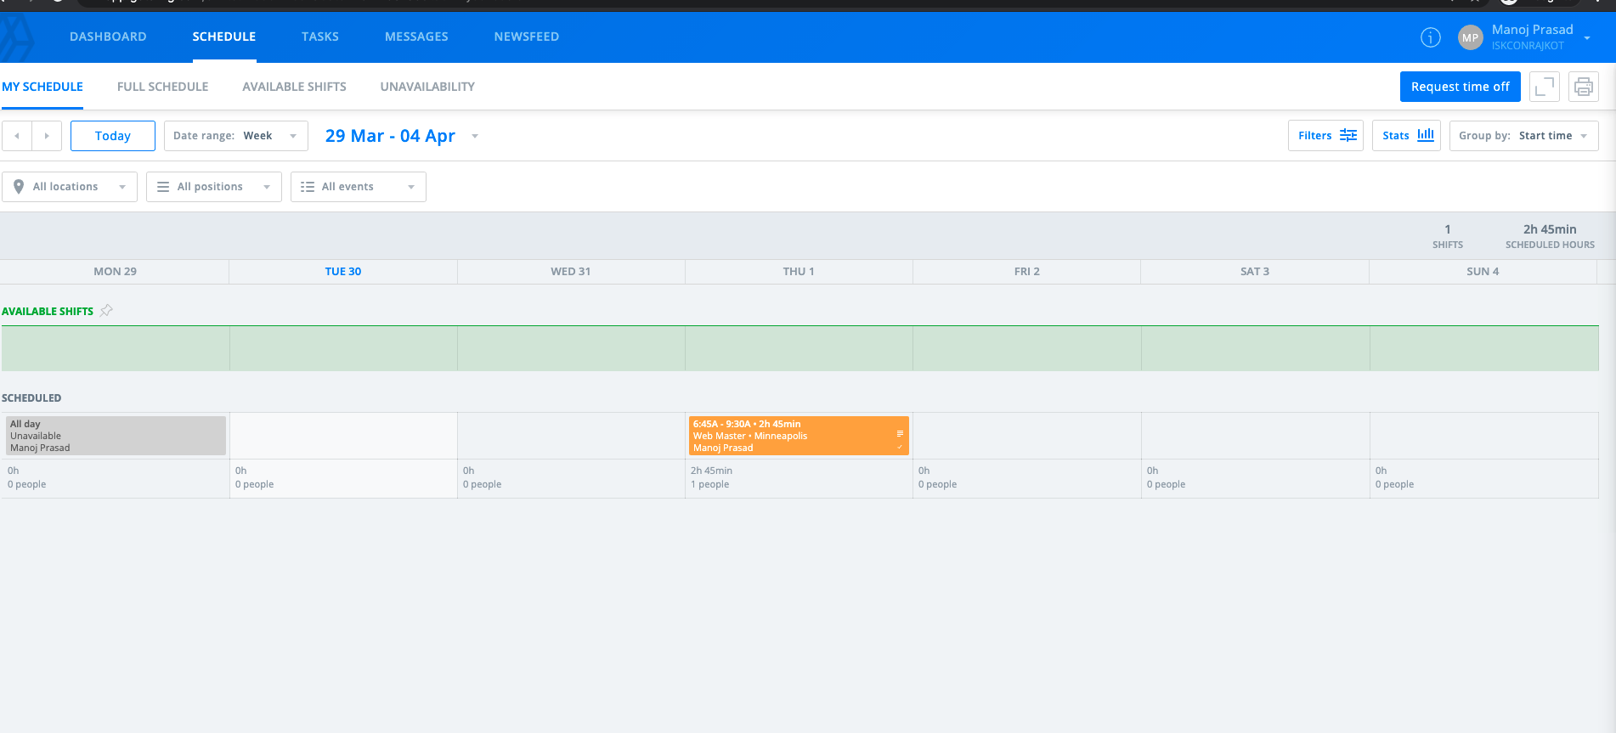
Employee - Schedule

Slide 20
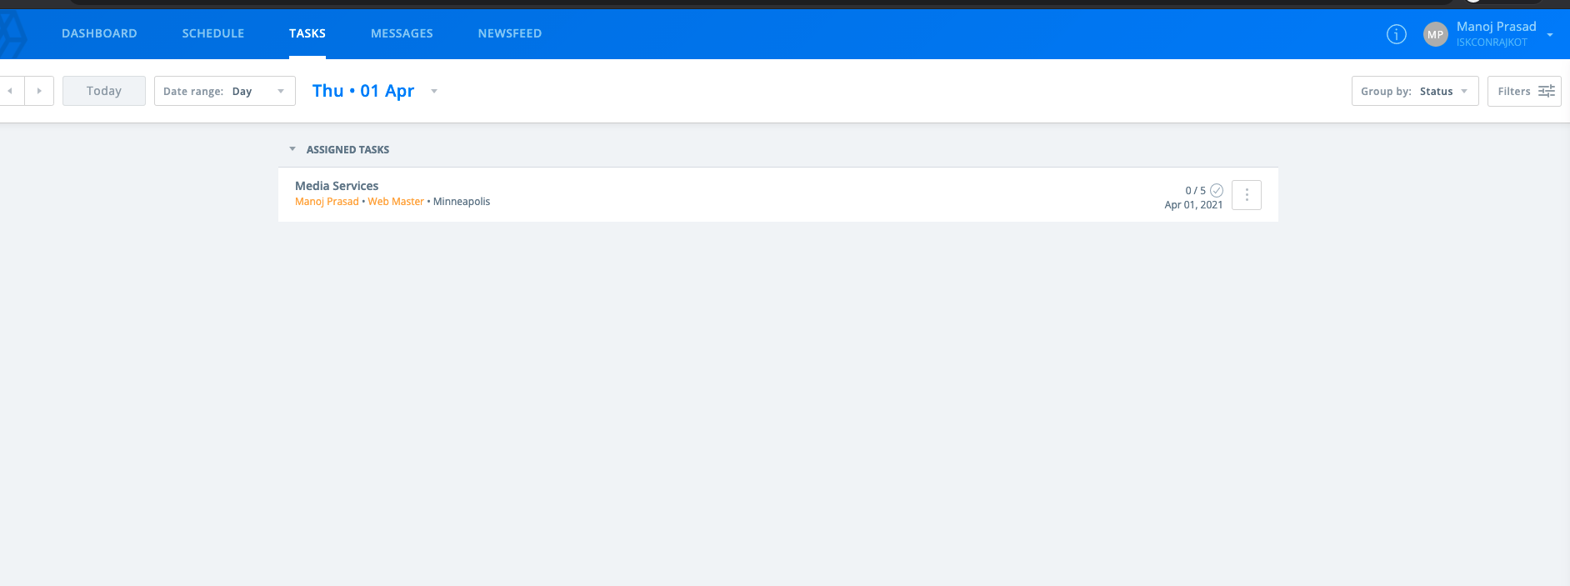
Tasks

Slide 21
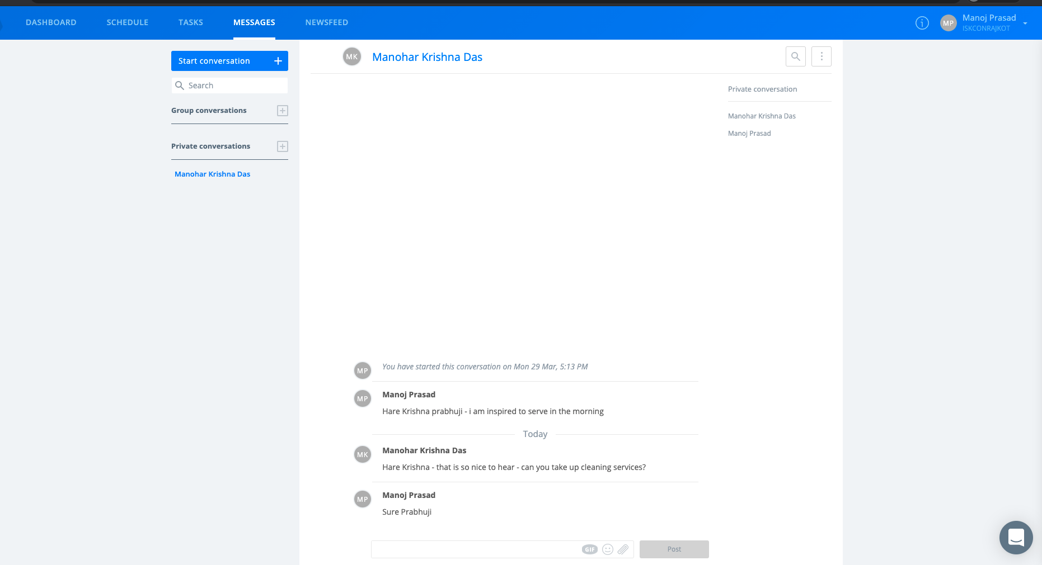
Employee - Messages

Slide 22
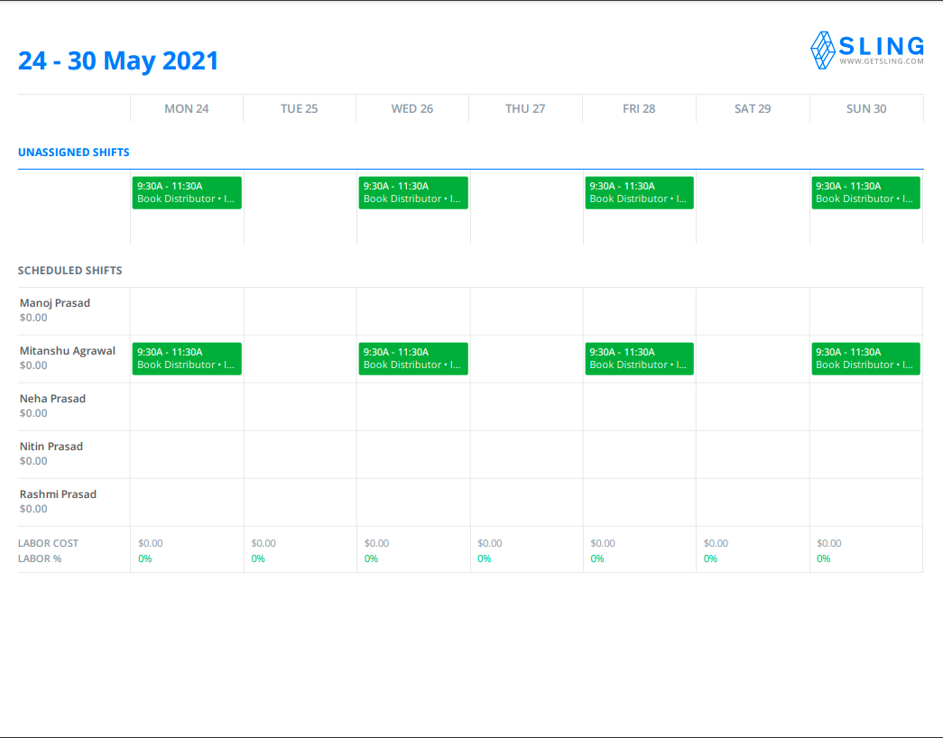

Slide 23
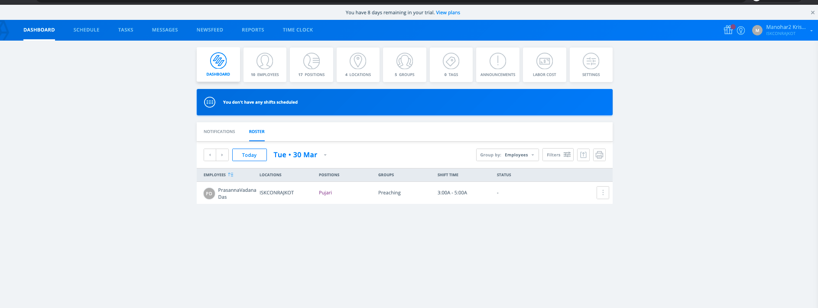
Manager – Dashboard Roster

Slide 24
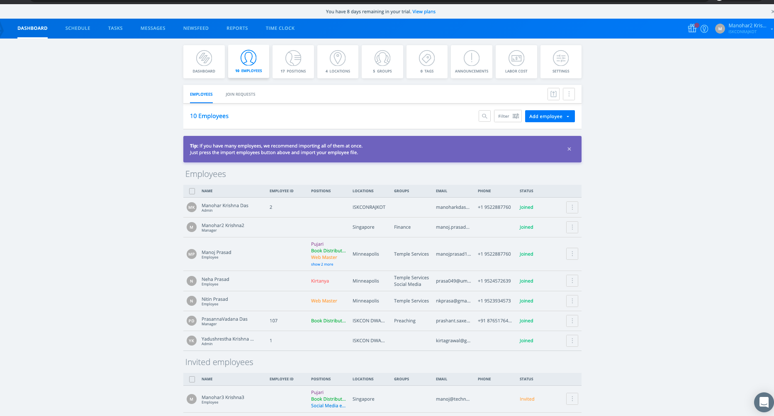
Manager Dashboard - Employees

Slide 25
Manager Dashboard - Positions

Slide 26
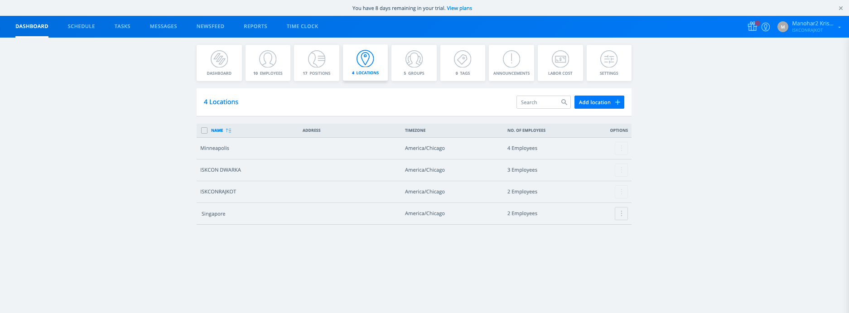
Manager Dashboard - Locations

Slide 27
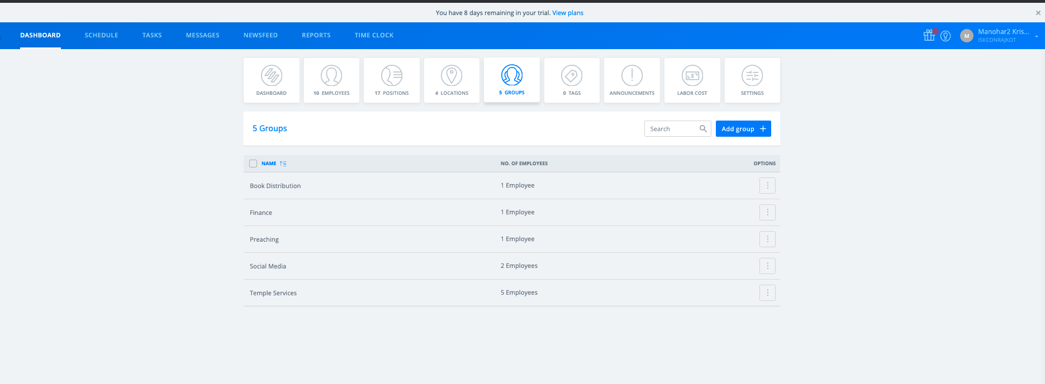
Manager – Dashboard groups

Slide 28
Manager Dashboard - Settings

Slide 29
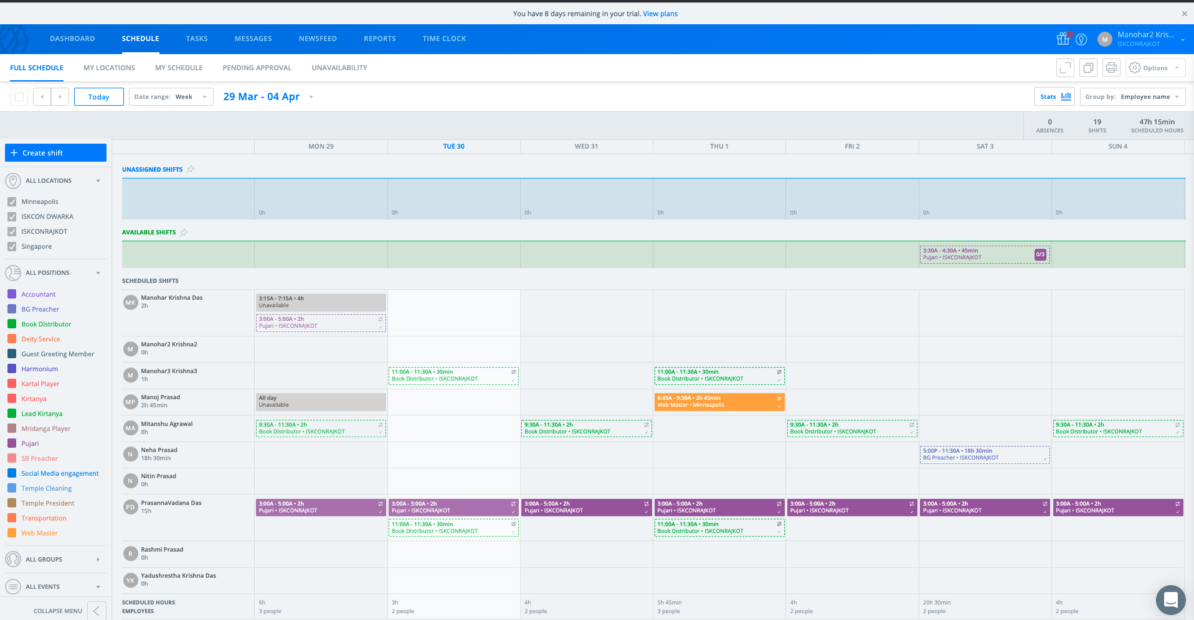
Manager Schedule

Slide 30
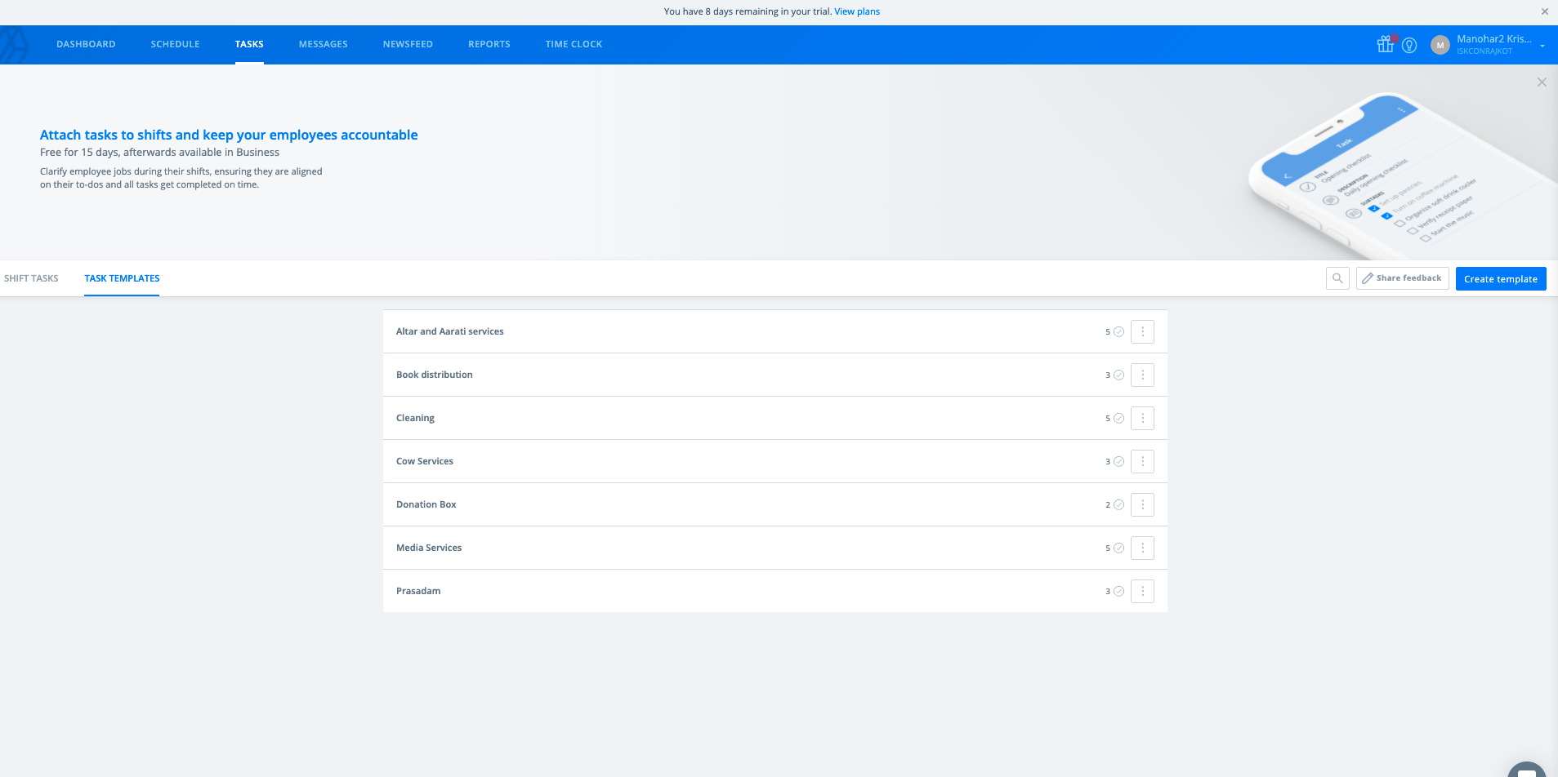
Manager Tasks

Slide 31
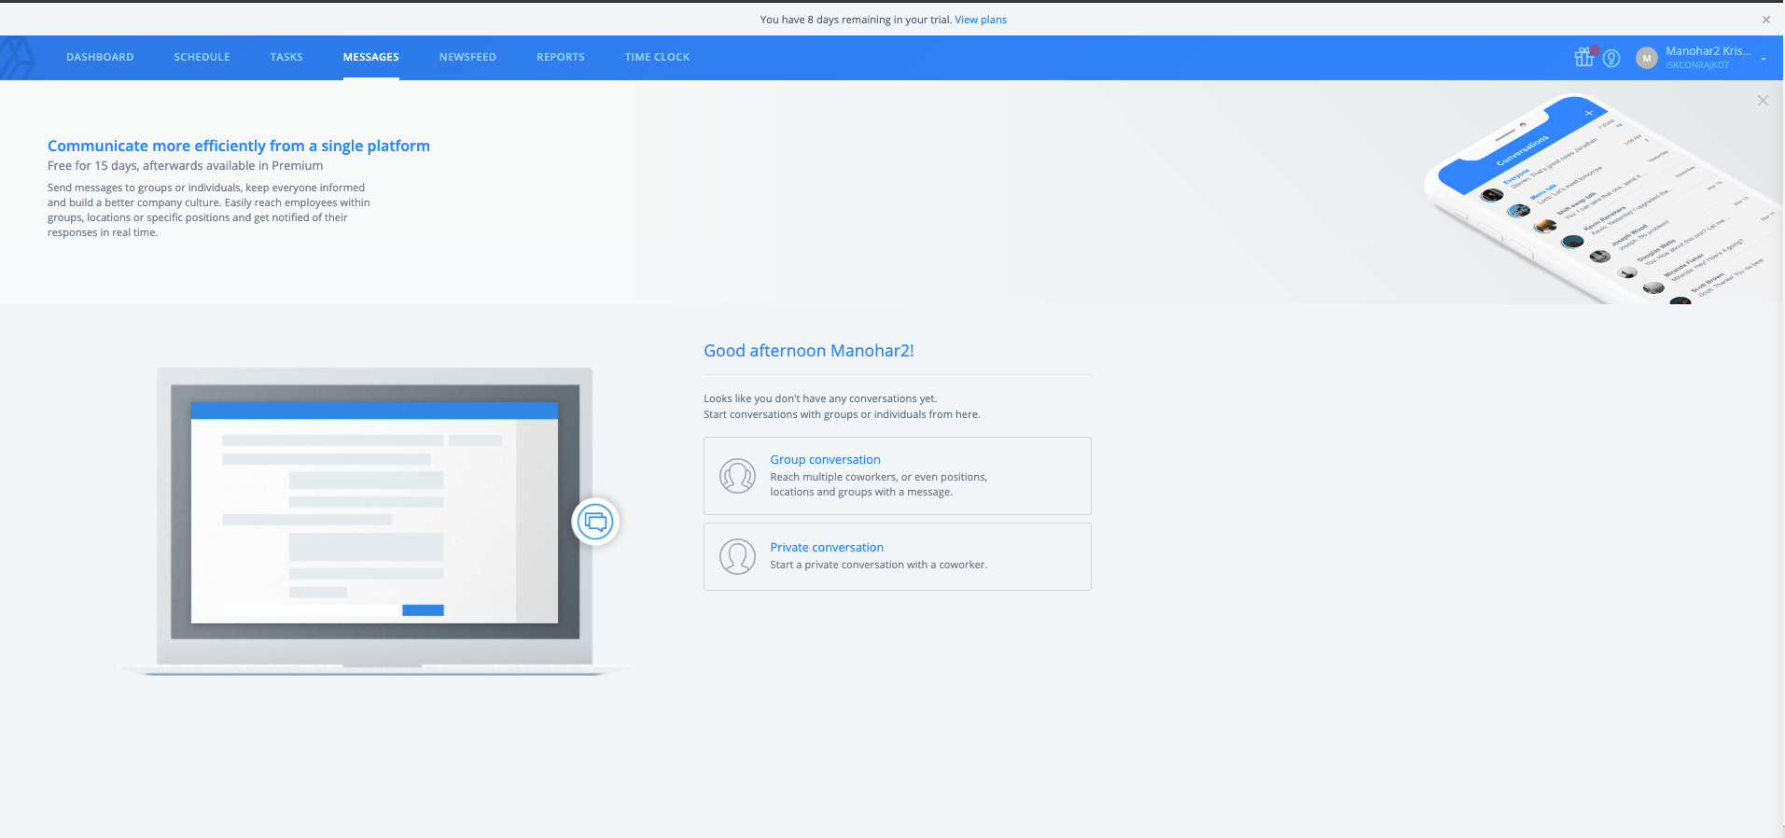
Manager Messages

Slide 32
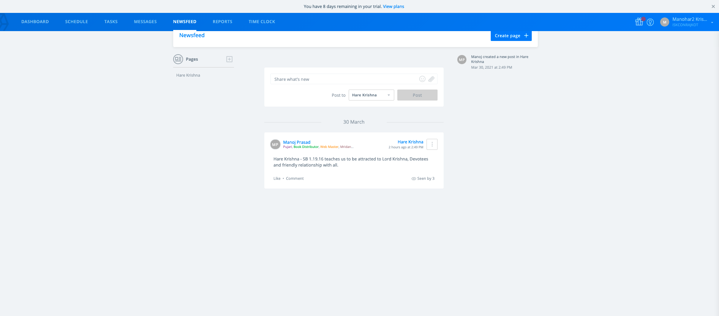
Manager Newsfeed

Slide 33
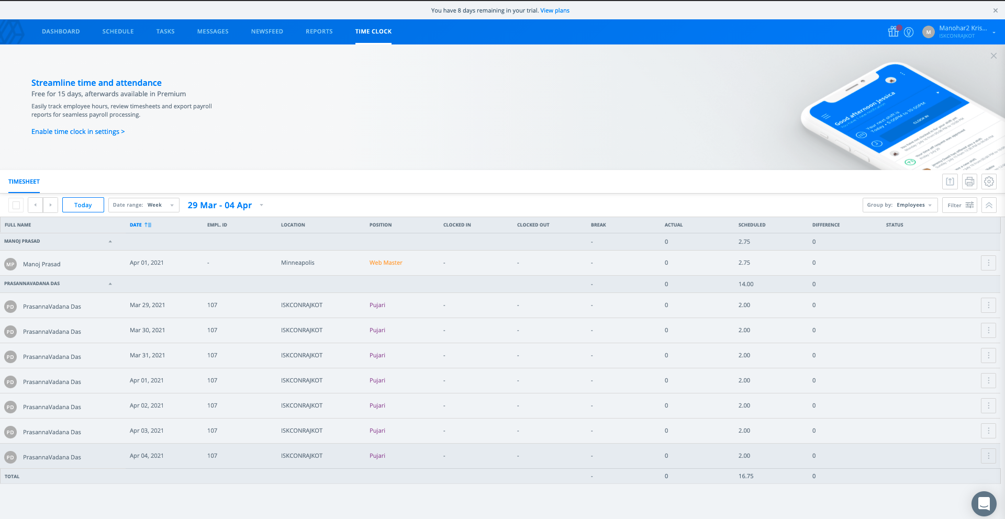
Manager Time Clock

Slide 34
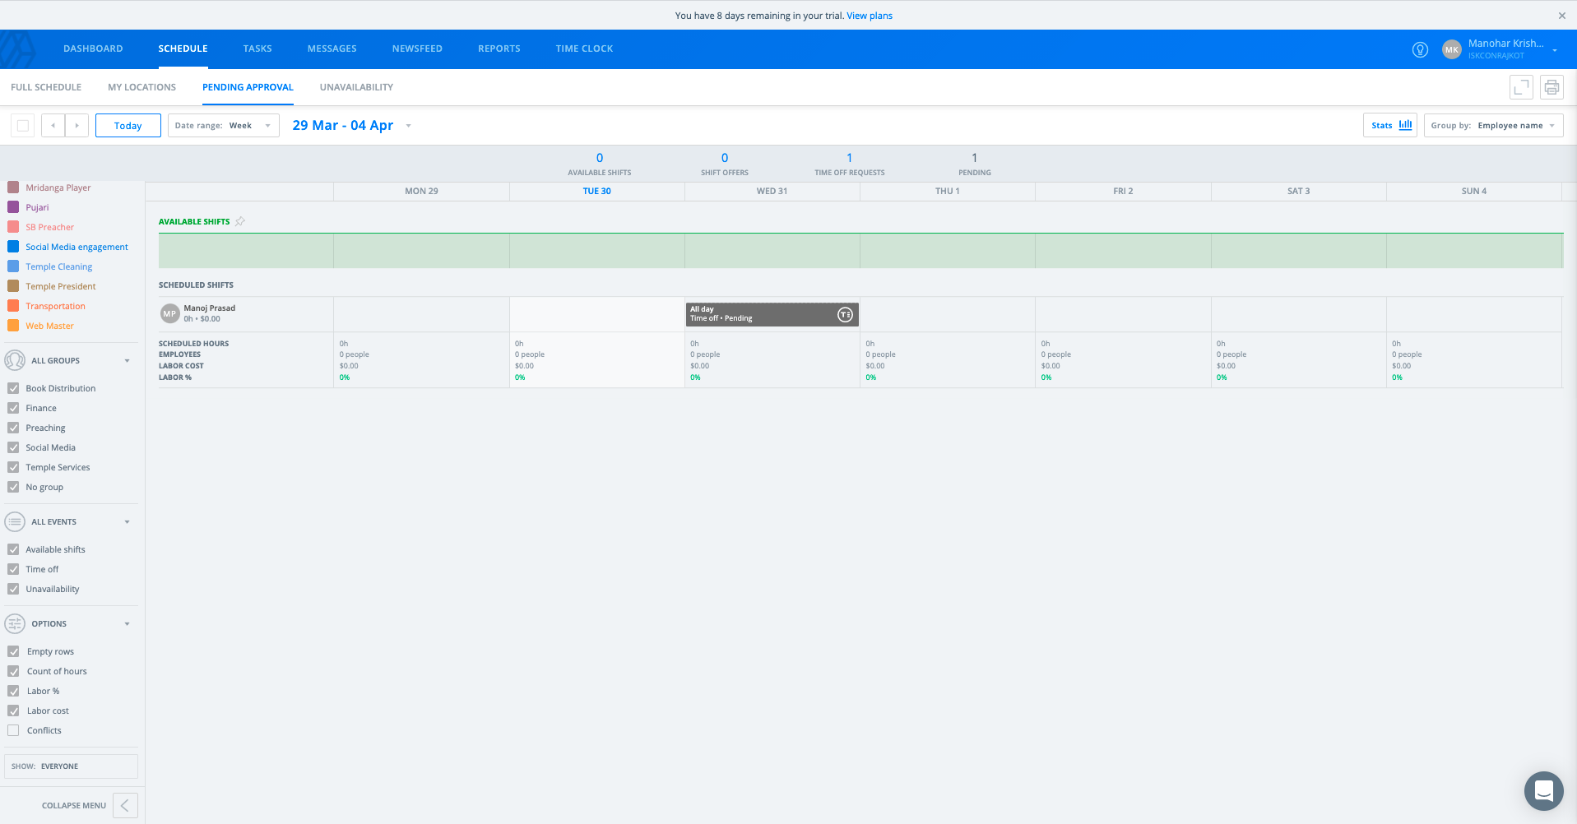
Admin Tasks

Slide 35
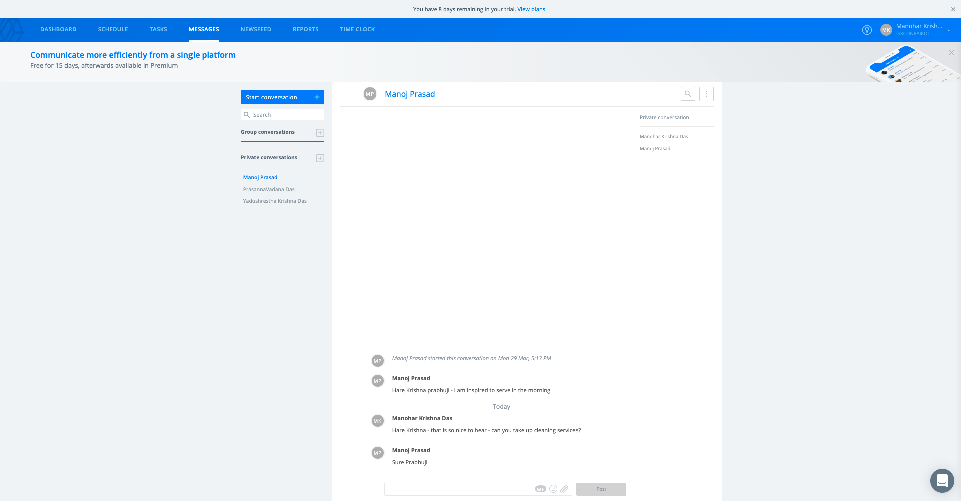
Admin Messages

Slide 36
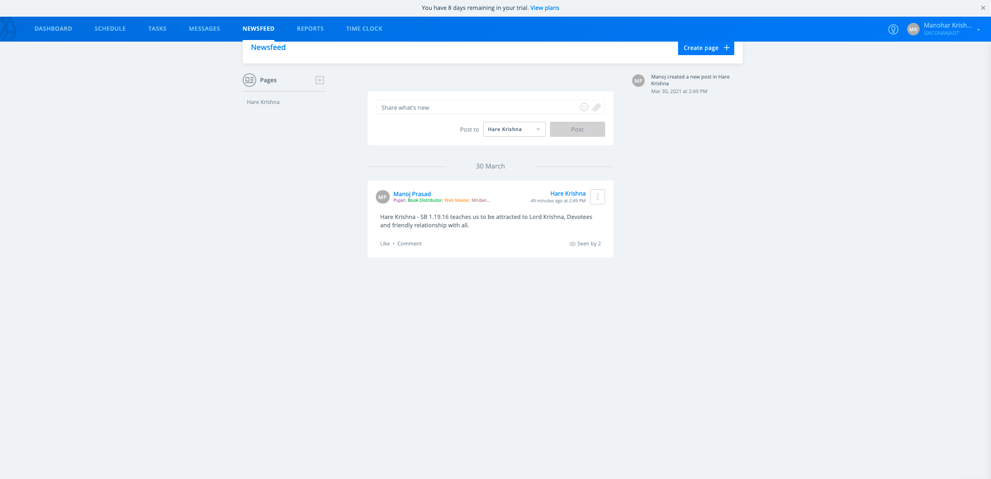
Admin - Newsfeed

Slide 37
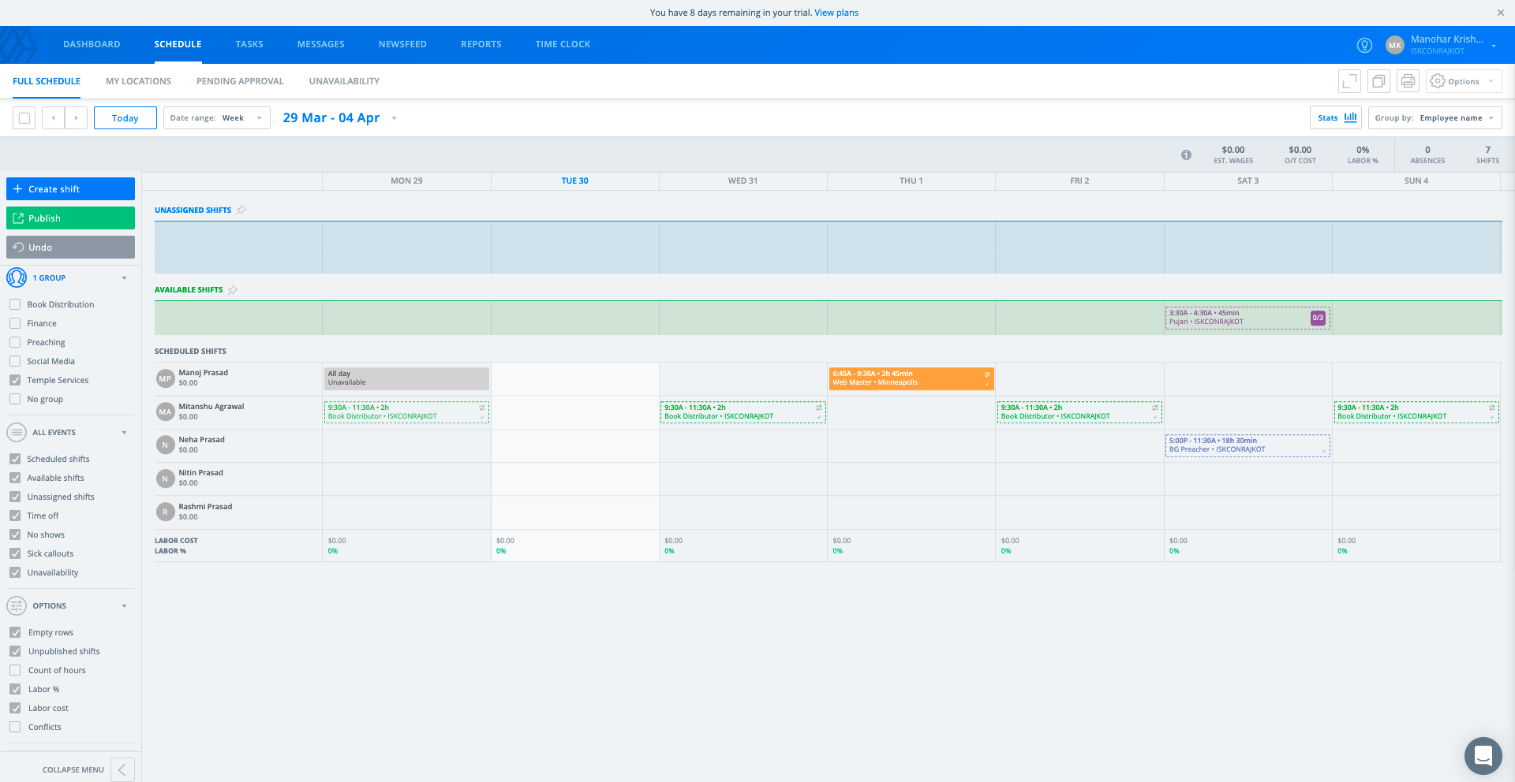
Admin Schedule – Full Schedule

Slide 38
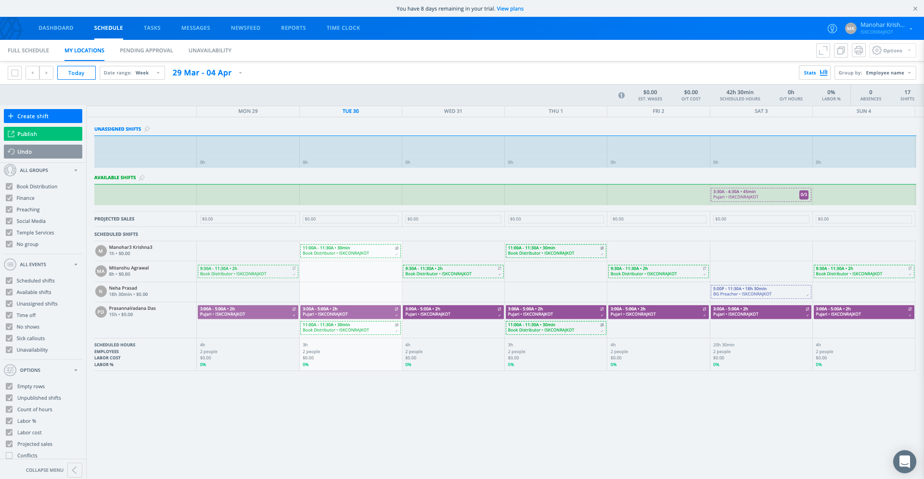
Admin Schedule – My Locations

Slide 39
Admin Schedule - Pending Approval

Slide 40
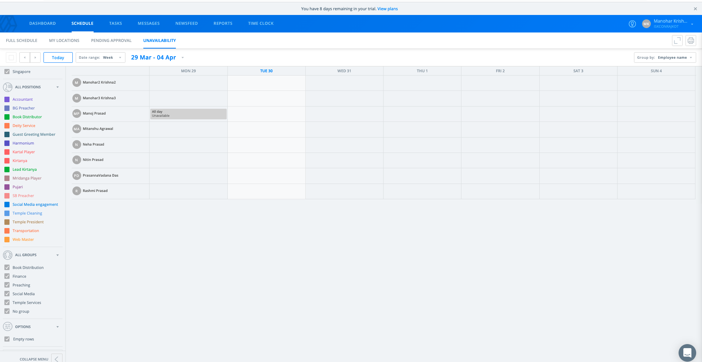
Admin Schedule - Unavailability

Slide 41
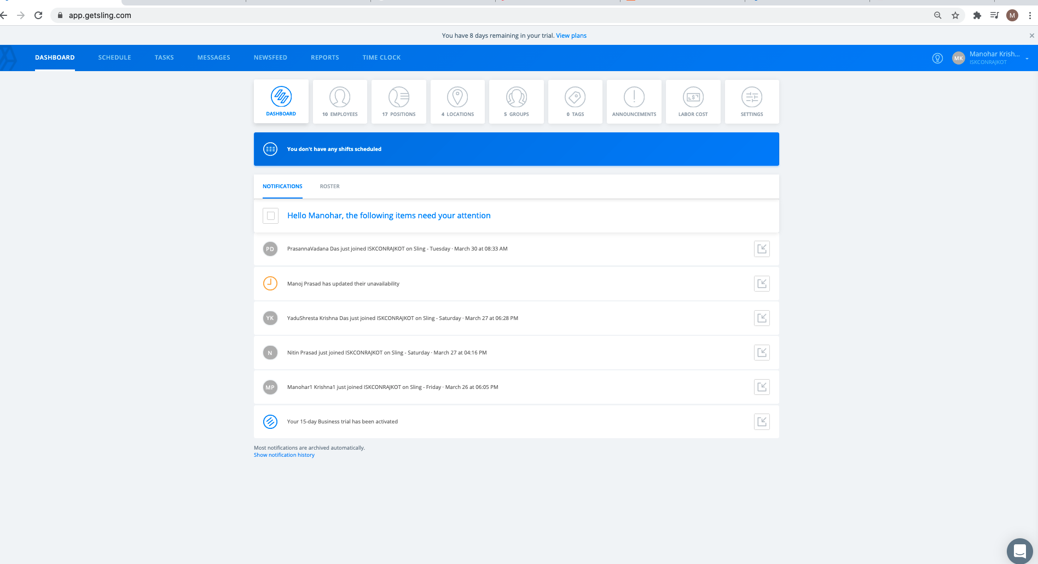
Admin Dashboard - Notifications

Slide 42
Admin Dashboard - Roster

Slide 43
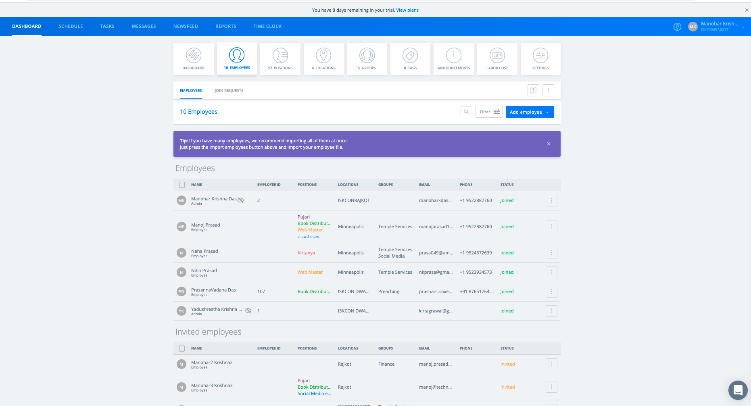
Admin Dashboard - Employees

Slide 44
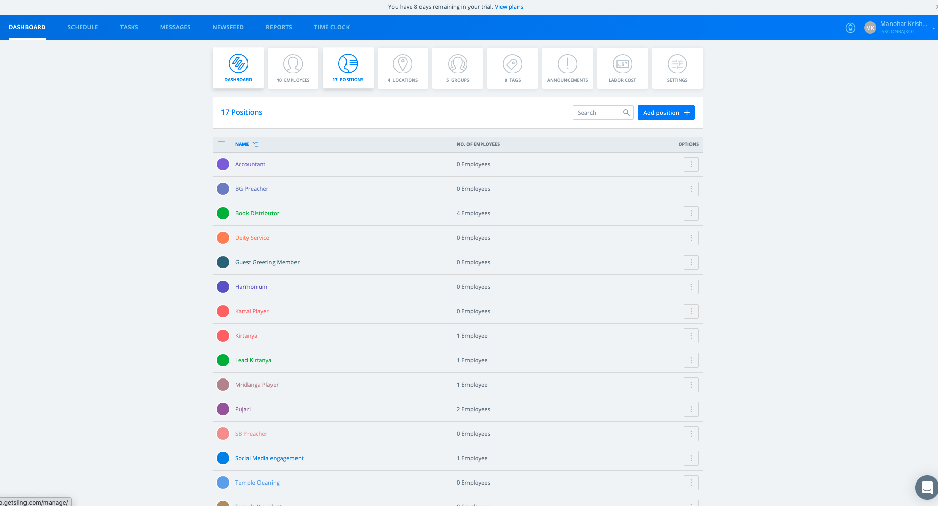
Admin Dashboard - Positions

Slide 45
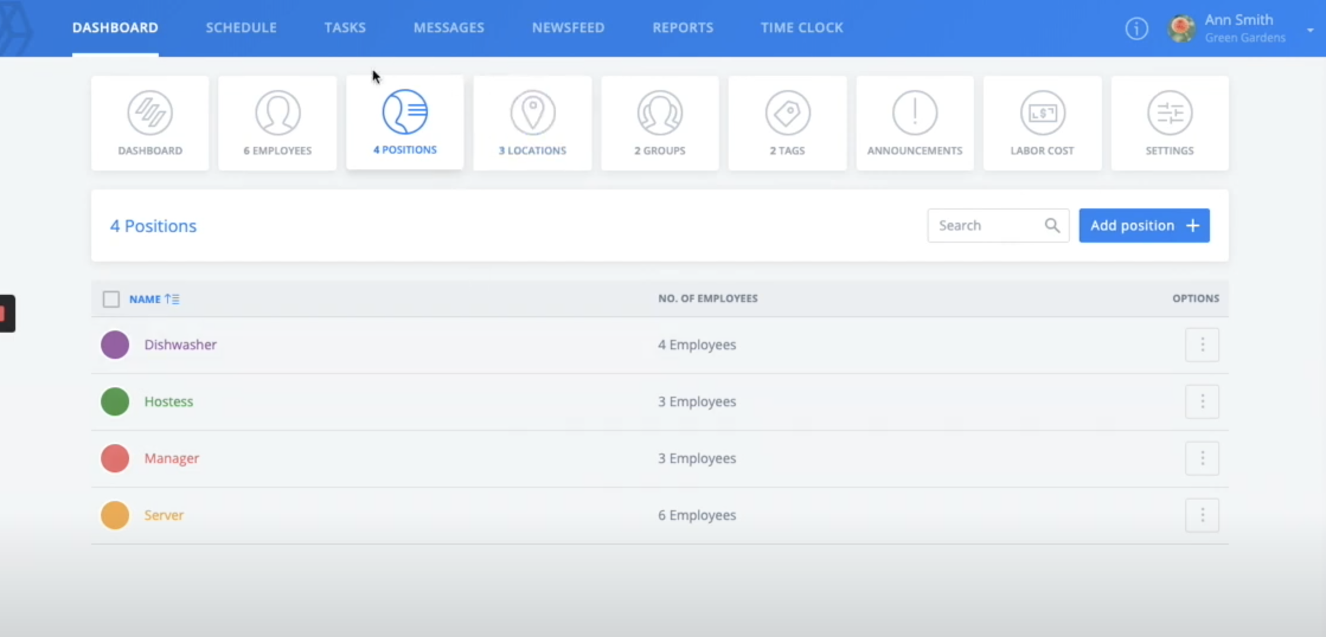
Positions

Slide 46
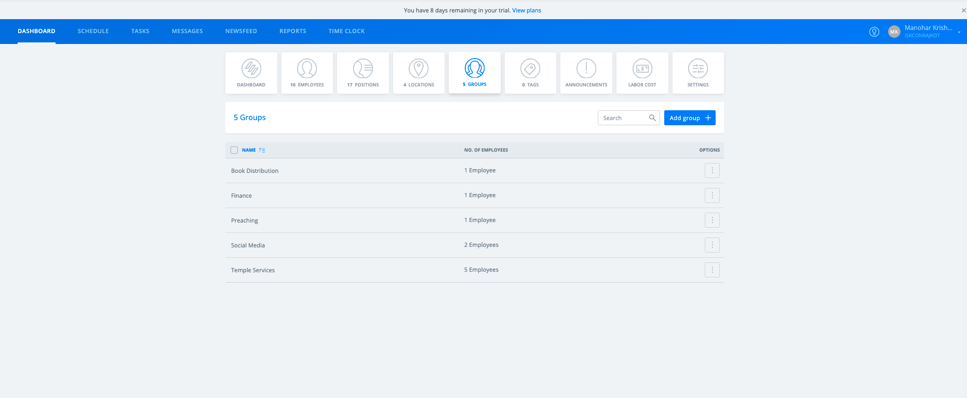
Admin Dashboard - Groups

Slide 47
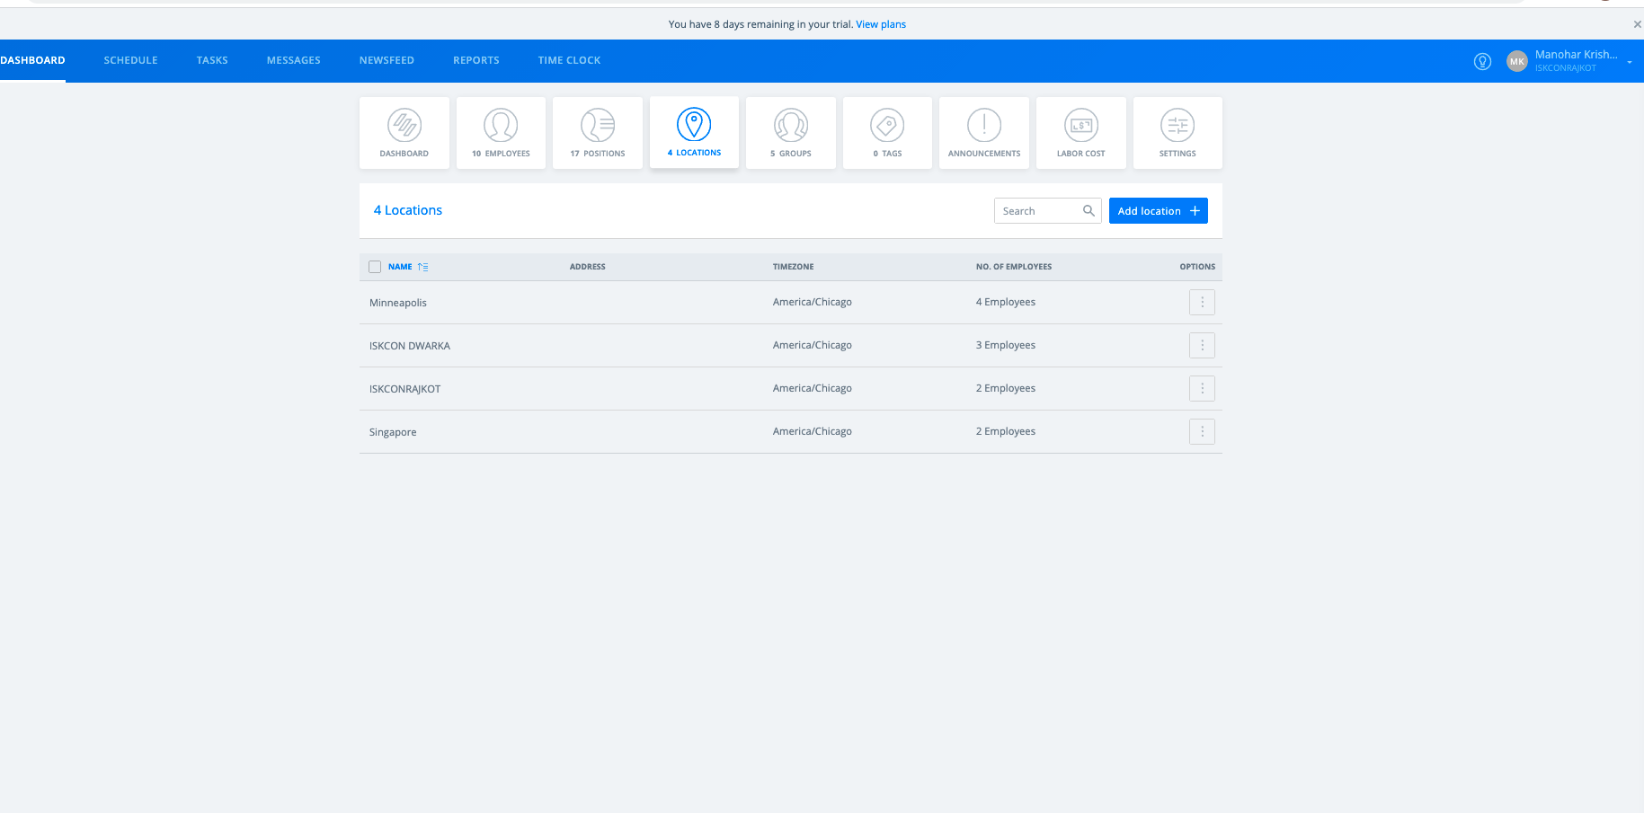
Admin Dashboard - Locations

Slide 48
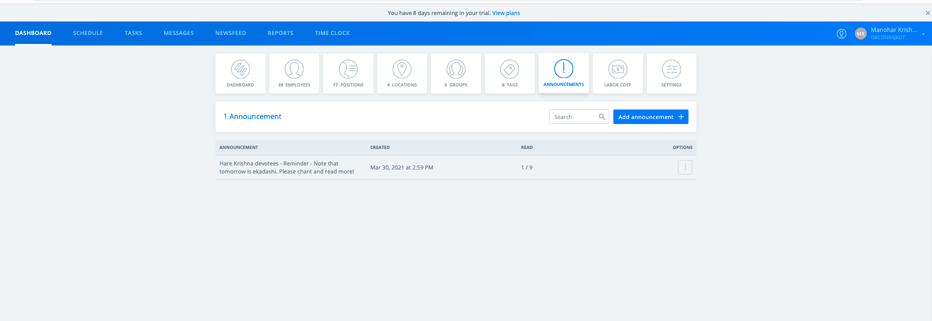
Admin Dashboard - Announcements

Slide 49
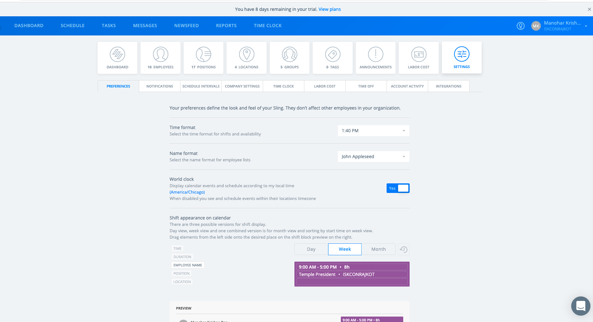
Admin Dashboard - Settings

Slide 50
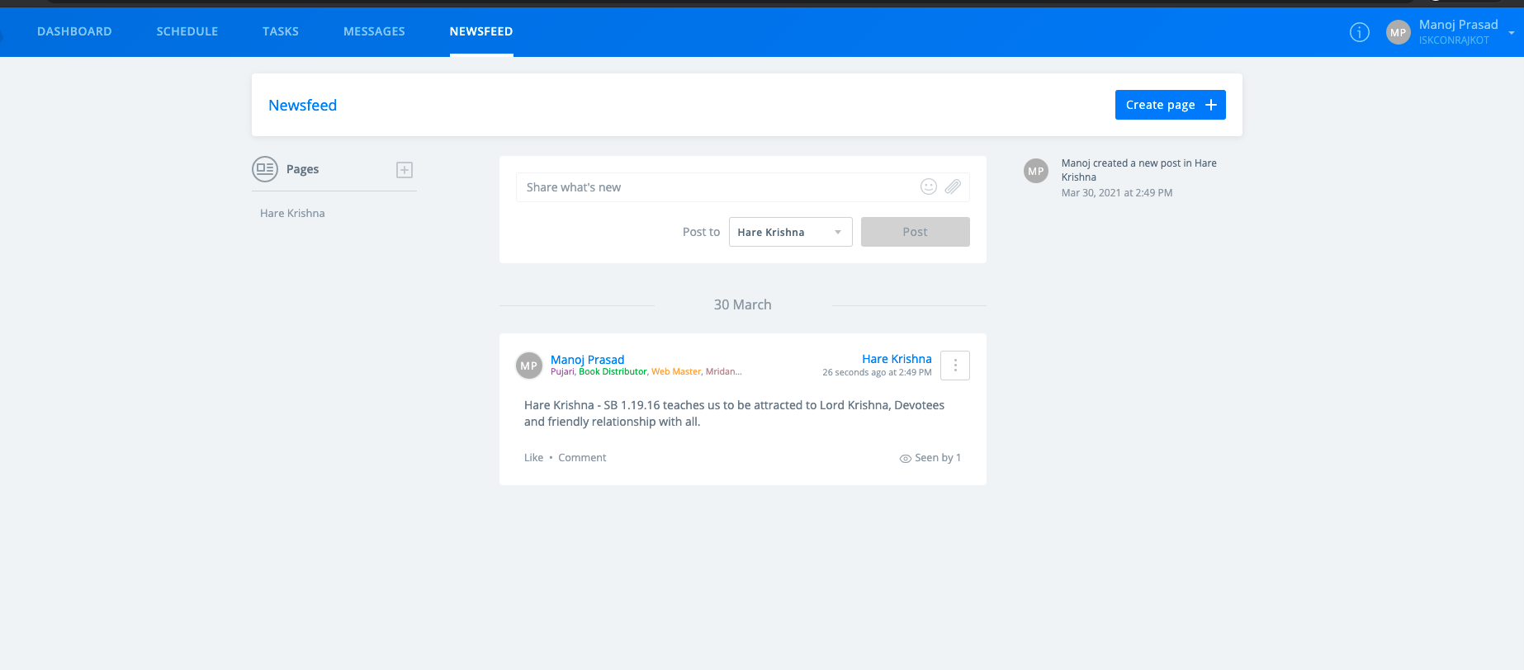
News Feed

